Slide 1
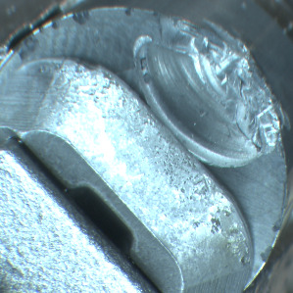
TOOL WEAR CLASSIFICATION
Machine learning in applications 2021/22
Claudio Tancredi, Francesca Russo, Alessandro Versace, Matteo Quarta

Slide 2
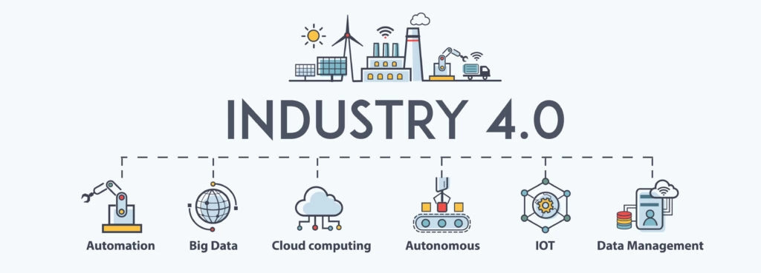



INTRODUCTION
+
=

Slide 3
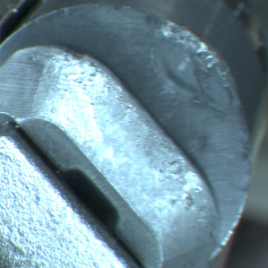

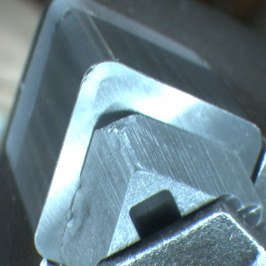
MONITOR WEAR STATE
Monitoring using
Instance Segmentation
Gathering
Replace

Slide 4
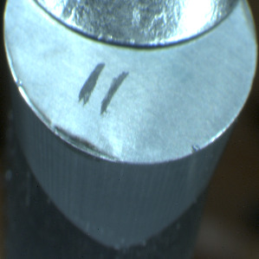
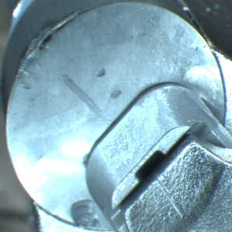
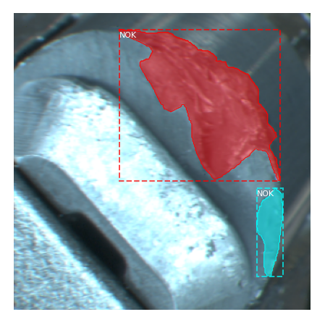
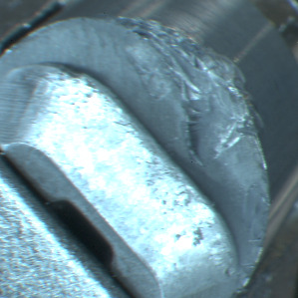
DATASET
RCGX12 (OK)
RNGN19 (DOUBT)
State of a component:
OK
NOT OK (NOK)
DOUBT
CNGA12 (OK)
RNGN12 (NOK)

Slide 5
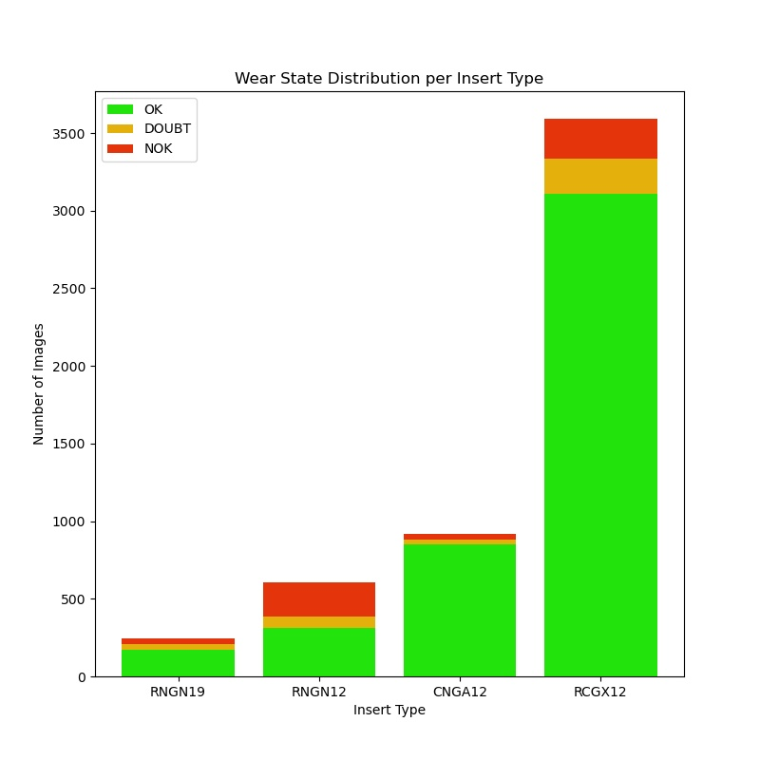
UNBALANCED AND BALANCED EXPERIMENTS
Highly skewed distribution is intrinsic in the task:
Train done both with an unbalanced and a balanced set
Test set still unbalanced to emulate a real scenario

Slide 6
METRICS
mAP @ 0.5
Accuracy
Per-class Accuracy
Ad-hoc metrics:
Critical
Semi-Critical
Instance Segmentation
# Correctly classified samples of class C
# Samples actually belonging to class C
# NOK samples classified as OK
# Samples belonging to NOK class
High cost errors
# NOK samples classified as DOUBT
# Samples belonging to NOK class

Slide 7
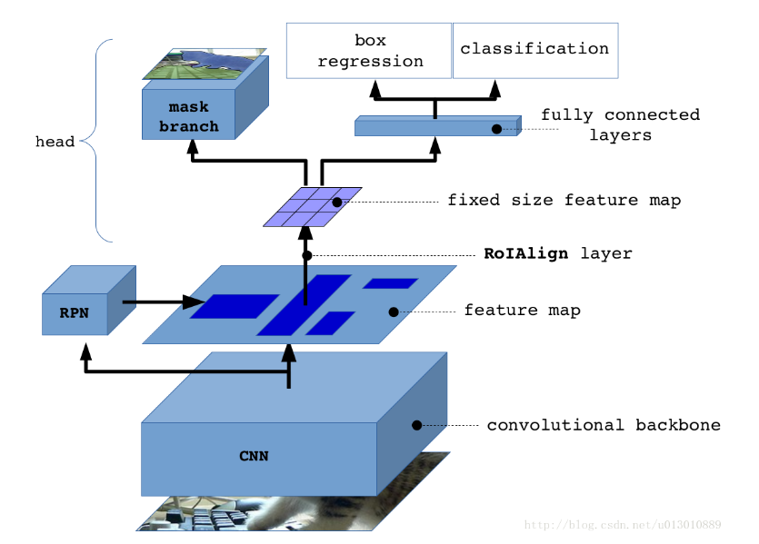
MASK R-CNN
Image credit: https://towardsdatascience.com/instance-embedding-instance-segmentation-without-proposals-31946a7c53e1

Slide 8
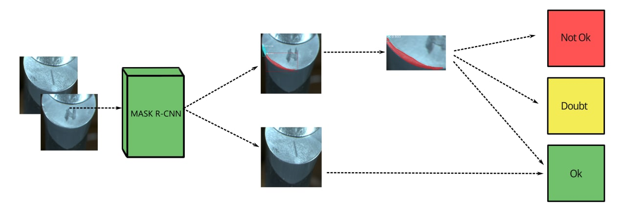
BASELINE MODEL

Slide 9
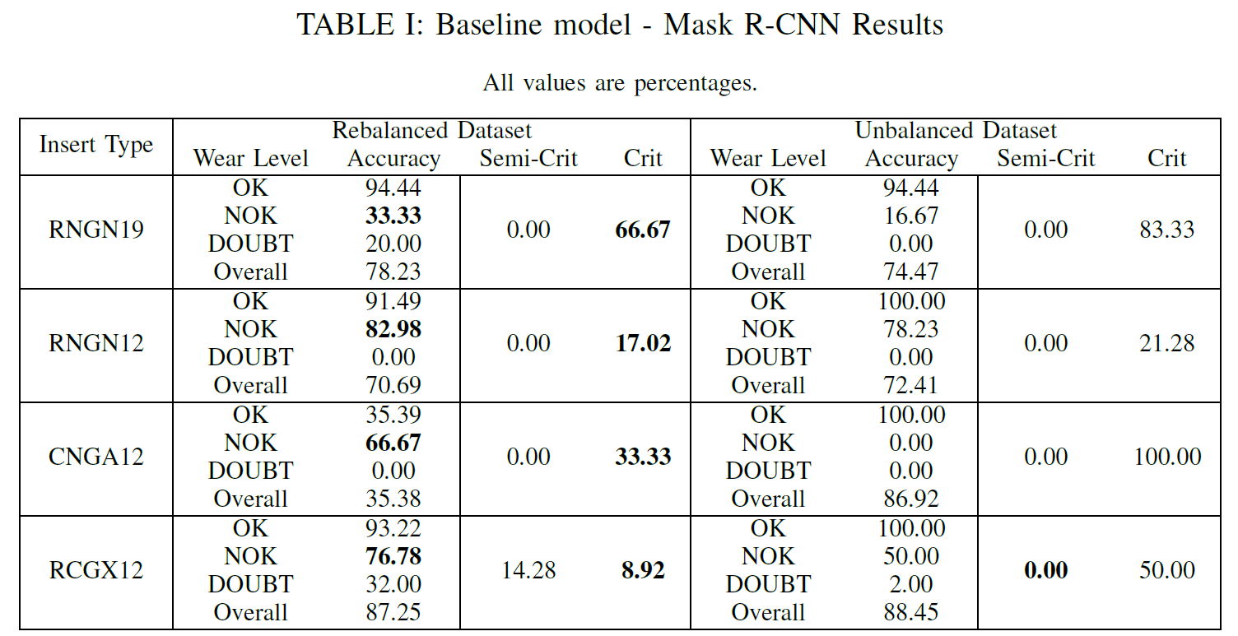
RESULTS

Slide 10
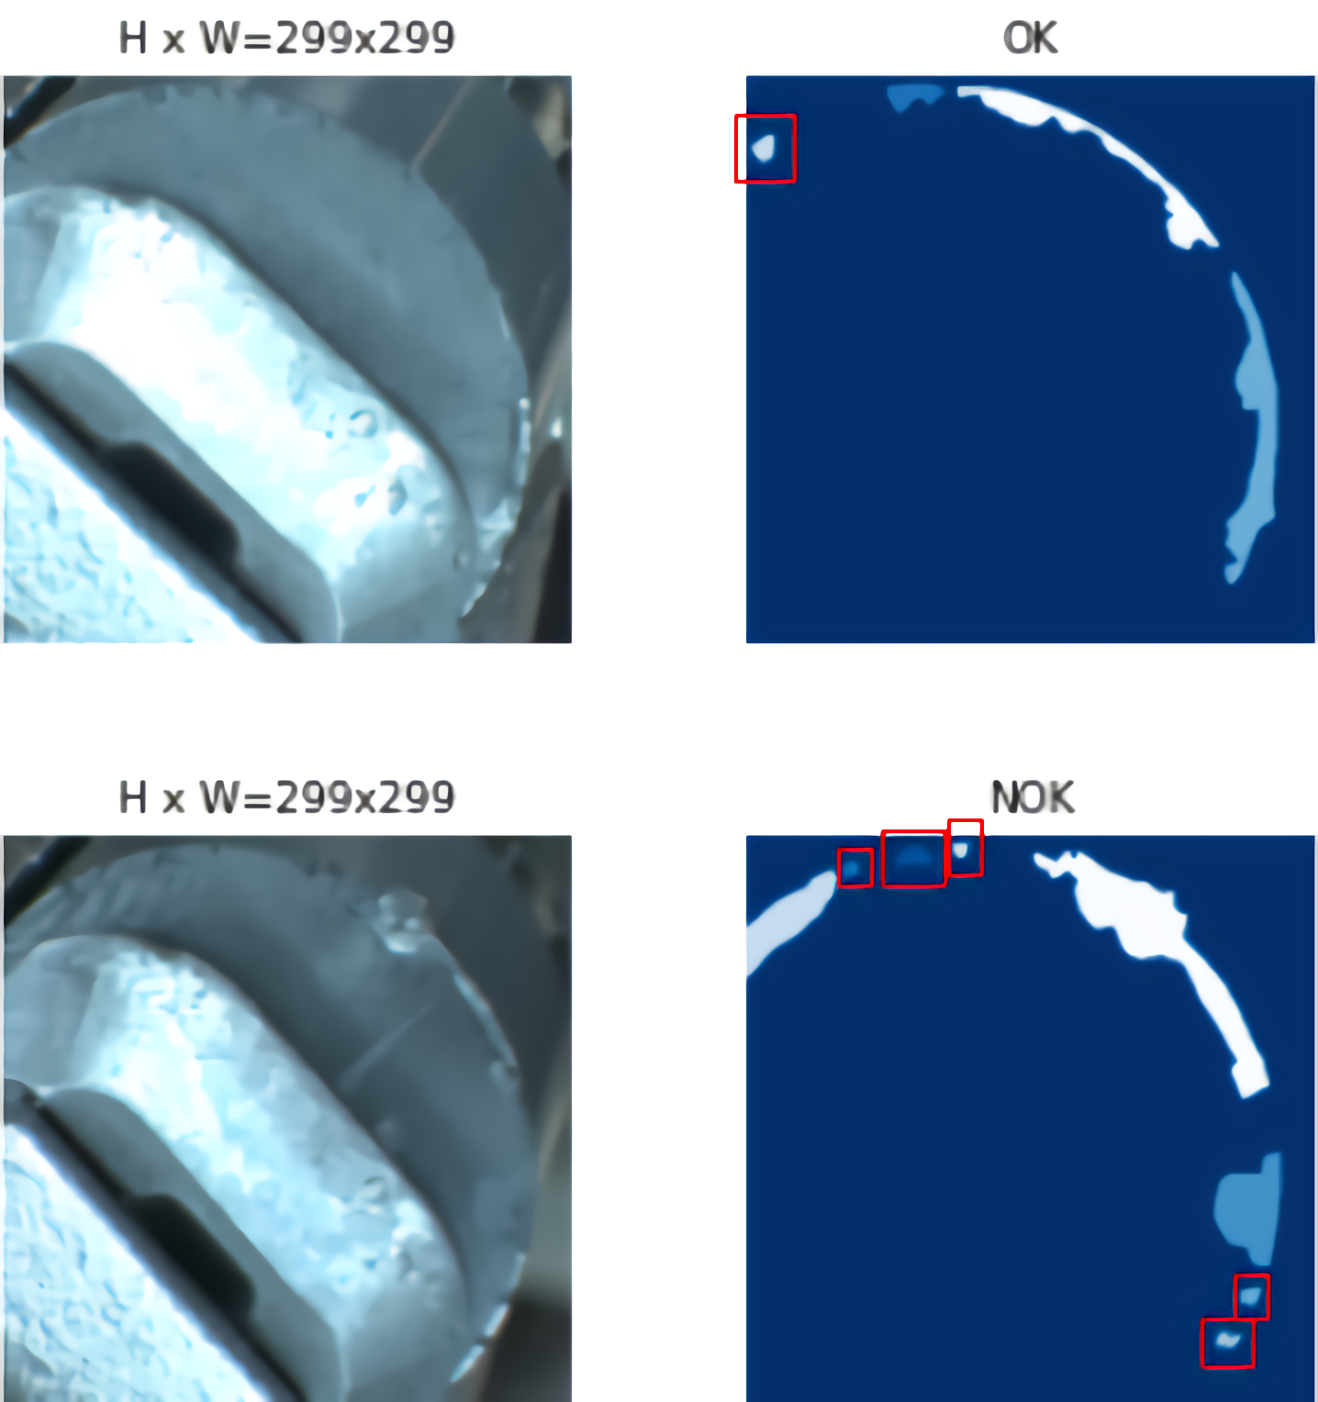
CRITICALITIES
Instance labelling is problematic!
High dependency on skilled operators

Slide 11
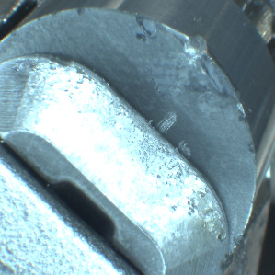
PROPOSED SOLUTION
Predicted label for region
Same label assigned to the whole image

Slide 12
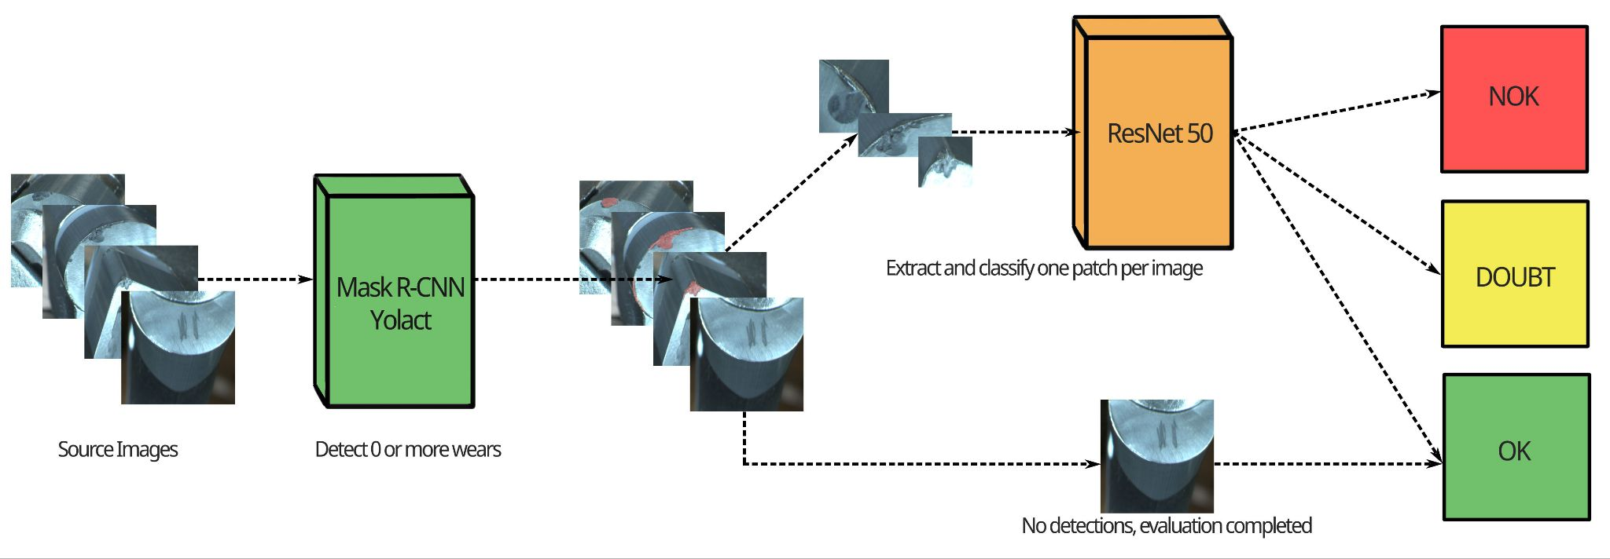
PIPELINE ARCHITECTURE
Mask R-CNN / YOLACT
Detect wears
ResNet 50
Classify wears
If no wear is detected, classified as OK

Slide 13
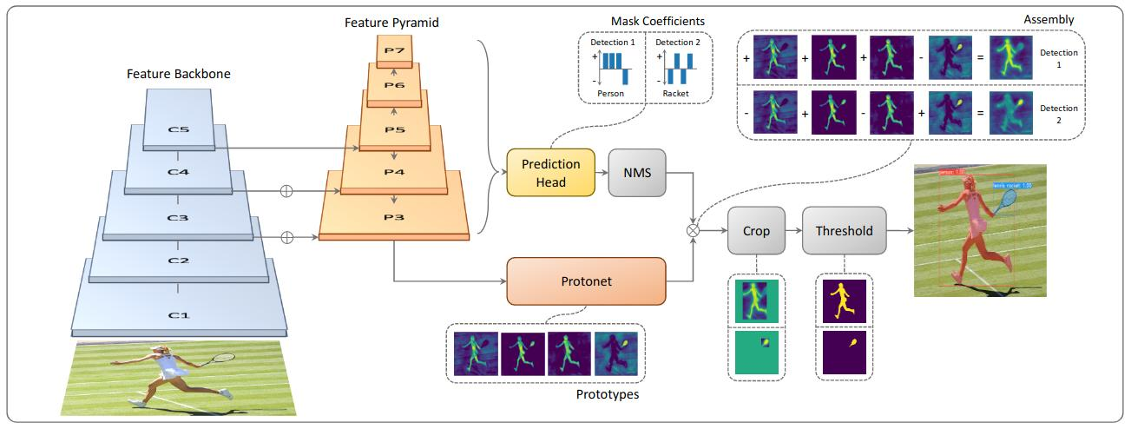
YOLACT
Primary focus on masks
“Boxes are stupid anyway”
Masks as linear combination of masks
Predict prototype masks
Predict prototype coefficients
Predict final masks
Image Credit: YOLACT: Real-time Instance Segmentation (https://arxiv.org/abs/1904.02689)

Slide 14
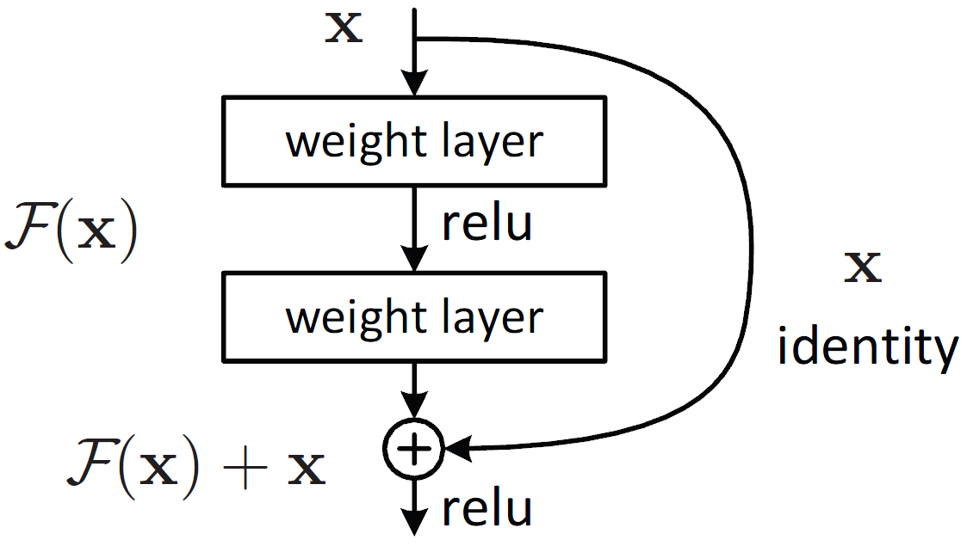
RESNET50
State of the art model for image classification
Various depth available
50 was picked as a performance/complexity compromise
Image Credit: Deep Residual Learning for Image Recognition (https://arxiv.org/abs/1512.03385)

Slide 15
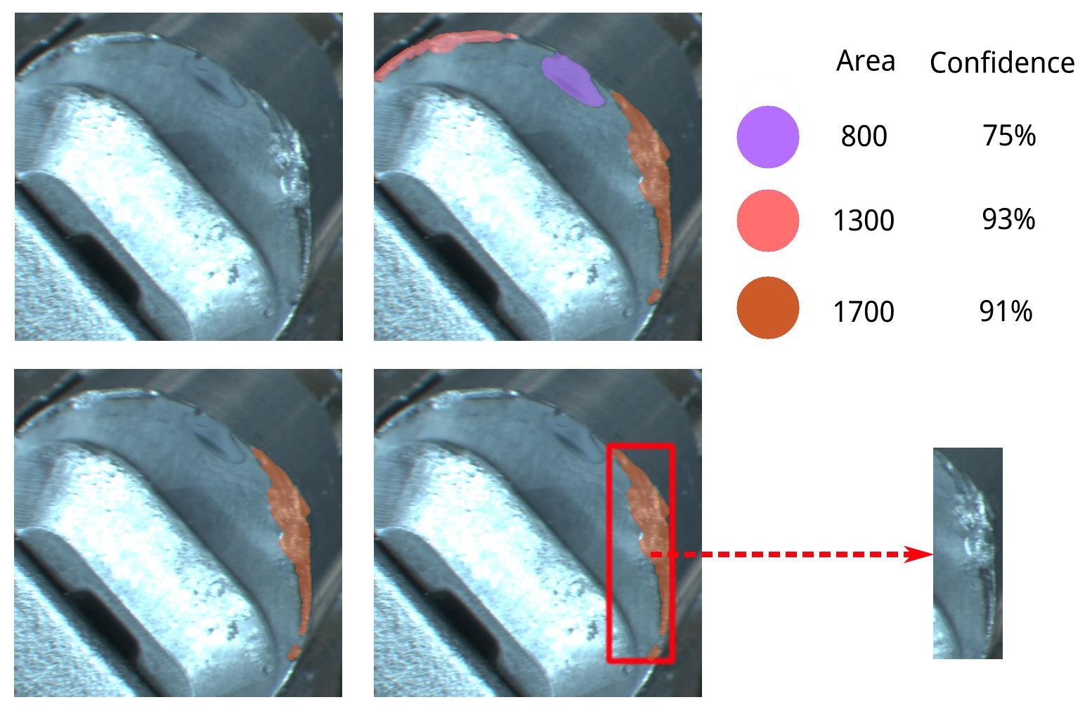
MASK DECISION CRITERIA
Zero or more masks are detected
At most one is kept
Threshold on detection confidence
80% for test split
95% for train and validation split
Rank based on wear size
Biggest one is kept
Compute bounding box from mask

Slide 16
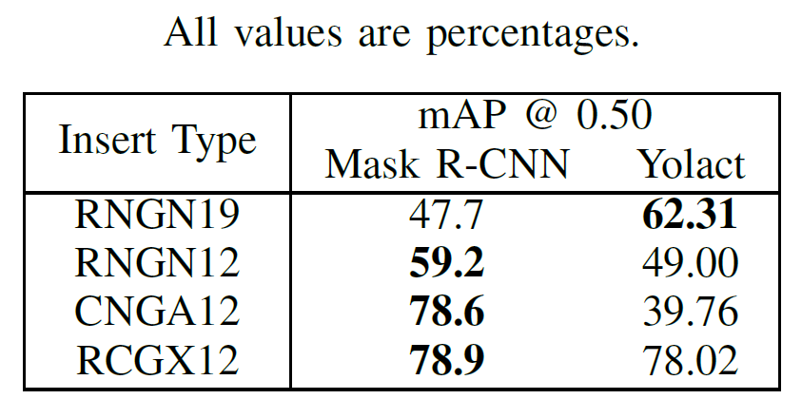
STAGE I RESULTS
Results in line with expectations
Stage I performance directly impact Stage II
See next slide

Slide 17
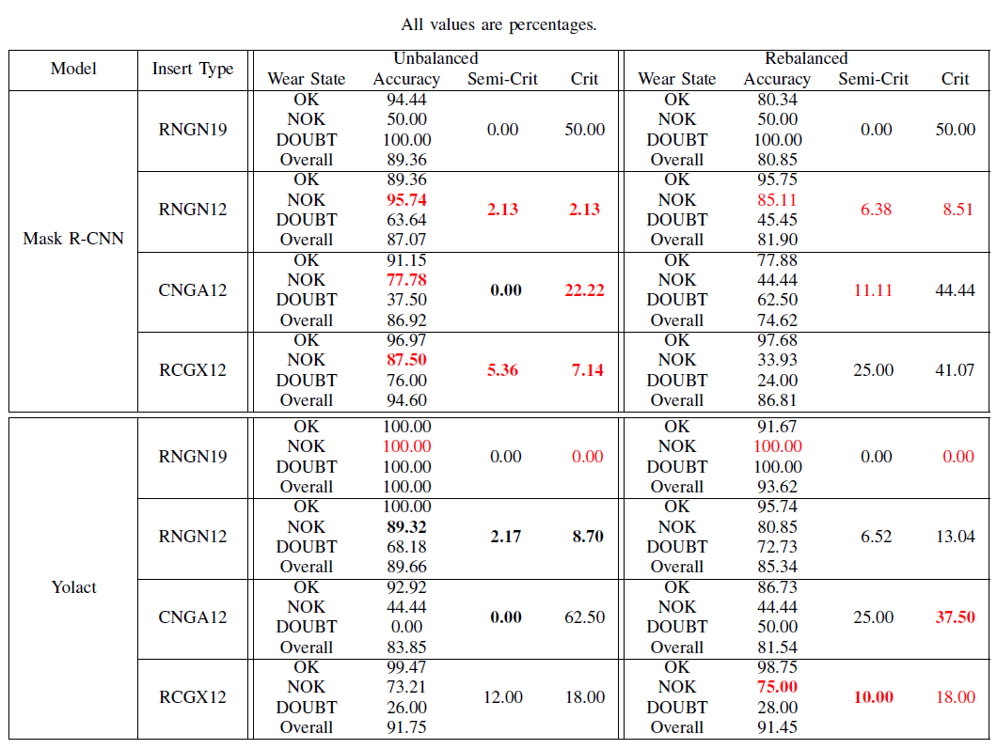
STAGE II RESULTS

Slide 18
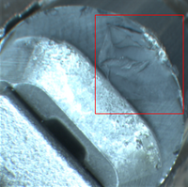
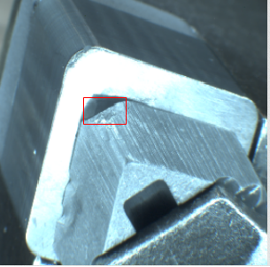
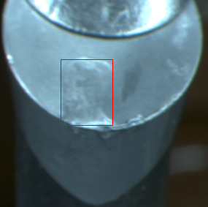
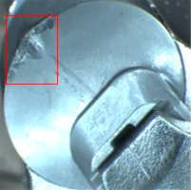
MASK R-CNN PIPELINE SAMPLES
State: NOK Predicted: NOK
State: OK Predicted: NOK
State: NOK Predicted: OK
RNGN12
Fair detection
State: NOK Predicted: NOK
CNGA12
Misleading elements
RCGX12
Box proposal limits
RNGN12
Fair detection

Slide 19
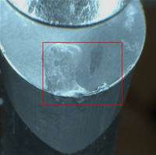
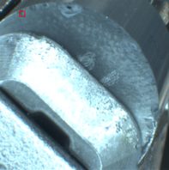
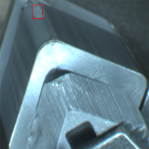
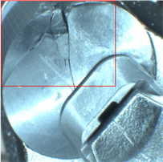
YOLACT PIPELINE SAMPLES
State: NOK Predicted: NOK
State: NOK Predicted: OK
State: NOK Predicted: NOK
RCGX12
Fair detection
State: NOK Predicted: NOK
RNGN12
Confidence struggle
CNGA12
Confusing detection
RNGN19
Fair detection

Slide 20
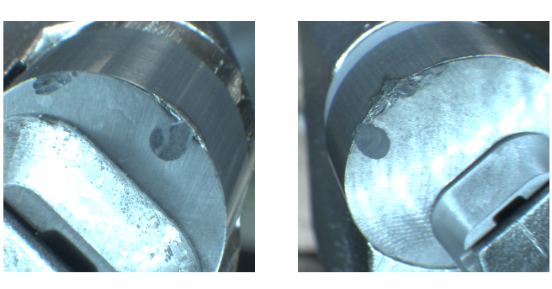
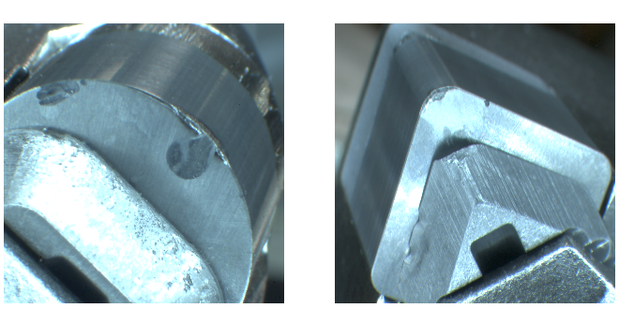
GENERALIZATION TESTS
BEST-CASE SCENARIO
WORST-CASE SCENARIO
RNGN12
RNGN19
RNGN12
CNGA12

Slide 21
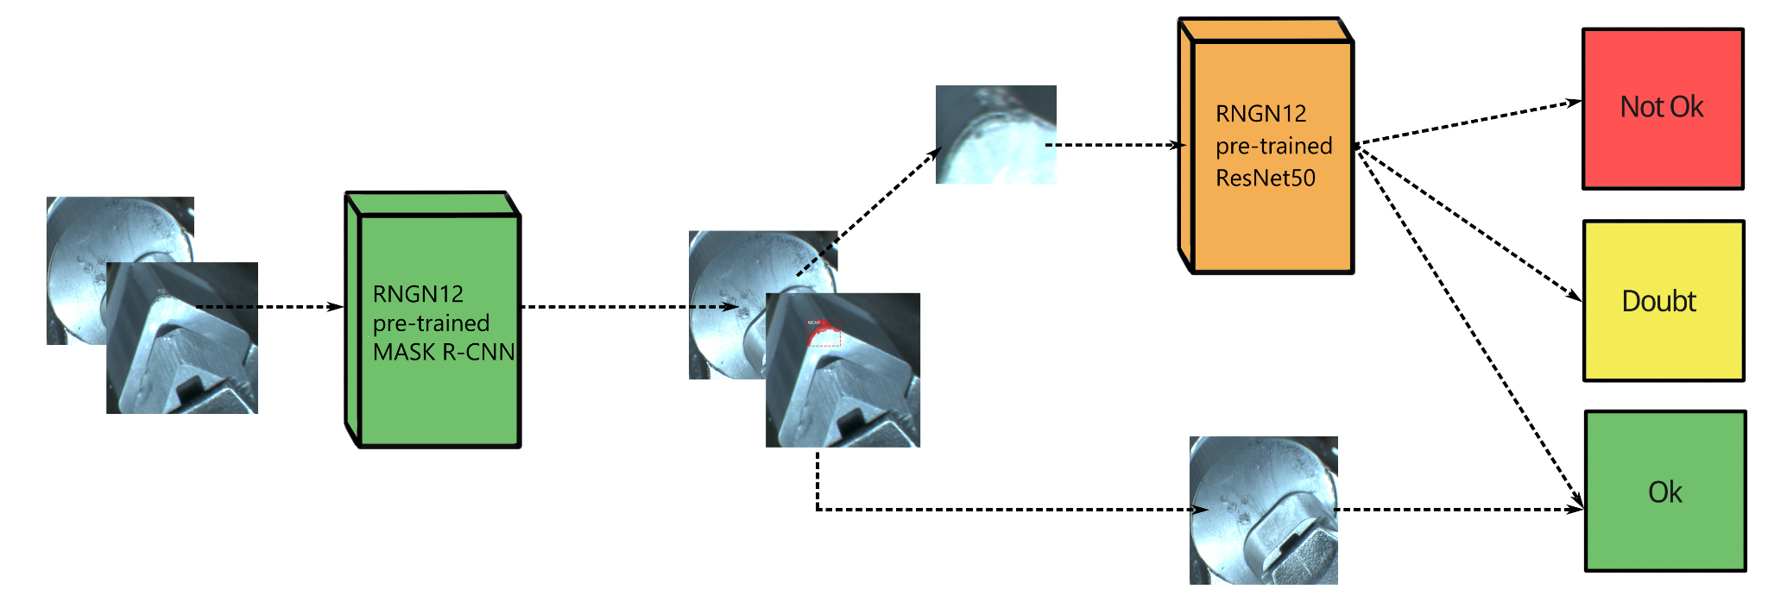
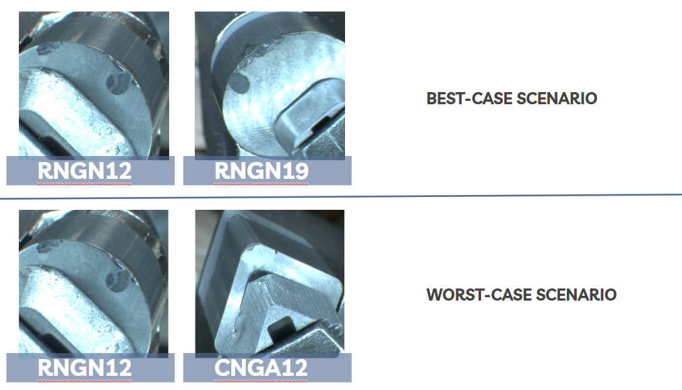
GENERALIZATION TESTS - METHOD

Slide 22
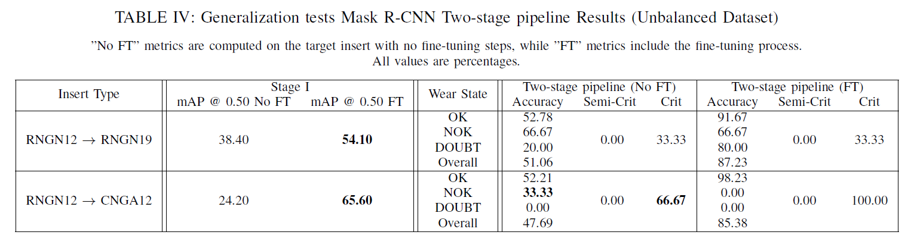
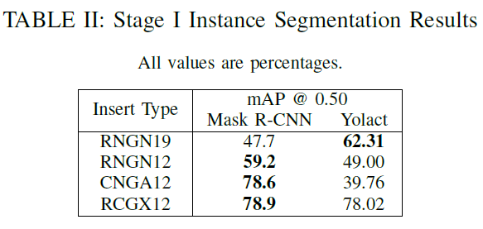
GENERALIZATION TESTS - RESULTS

Slide 23
INCONSISTENT INSTANCE SEGMENTATION ANNOTATIONS
HUMAN AND ECONOMIC RESOURCES OPTIMIZATION
REAL-TIME MONITORING: WORTH IT?
CONCLUSIONS
Problem solved by our two-stage pipeline, which associates the classification label to the largest detected worn area.
The presence of a highly qualified human operator in the instance segmentation labeling phase is not necessary anymore.
It depends on the compromise between speed and correctness.

Slide 24
USE OF DIFFERENT REBALANCING STRATEGIES
WE WANT MORE… EXPERIMENTS
CLASSIFIER DIRECT INTEGRATION IN STAGE 1 ARCHITECTURE
FUTURE WORKS
But beware of possible drawbacks!
DOUBT and NOK classes oversampling instead of OK class downsampling.
Lots of different combinations of generalization tests can be run.

Slide 25

THANK YOU FOR YOUR ATTENTION
GitHub project repository

